Slide 1
Chapter 6
CENTROIDS
Animut A.

Slide 2
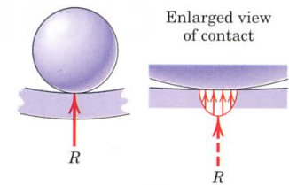
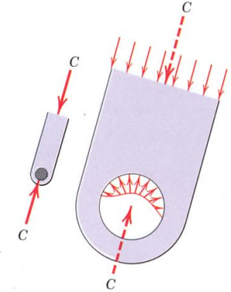
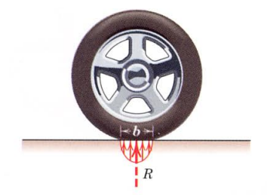
6.1 Introduction
Distribution of Force

Slide 3
Force Distribution
There are three categories of the intensity of the force at any location.

Slide 4
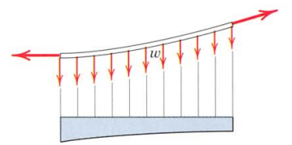
Line Distribution
E.g continuous vertical load supported by a suspended cable

Slide 5
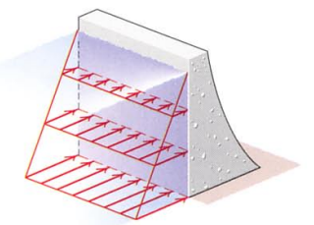
2. Area Distribution
E.g the hydraulic pressure of water against the inner face of a section of dam

Slide 6
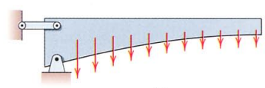
Volume Distribution
Eg. the most common body force is the force of gravitational attraction,

Slide 7
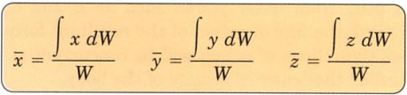
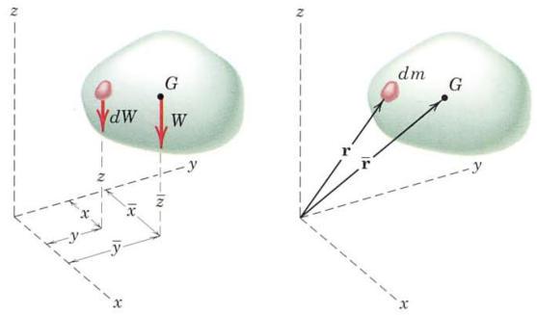
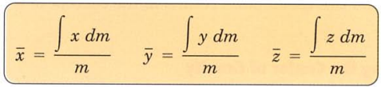
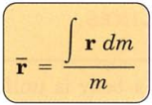
6.2 Centers of Mass, Center of Gravity and Centroid
By applying principle of moments Center of Gravity
Center of mass
Center of Mass

Slide 8
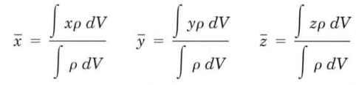
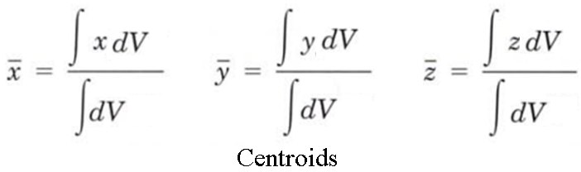
6.2 Centers of Mass, Center of Gravity and Centroid

Slide 9
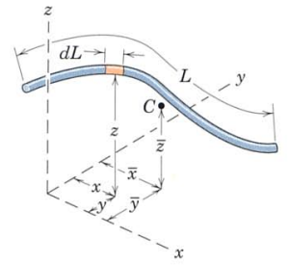
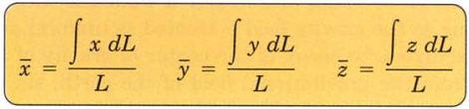
6.2.1 Centroids of Line, Areas and Volume
Centroid of Line

Slide 10
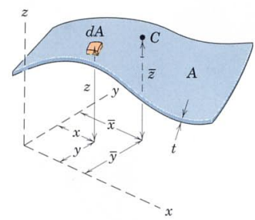
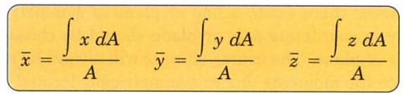
6.2.1 Centroids of Line, Areas and Volume
Centroid of Area

Slide 11
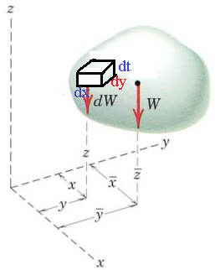
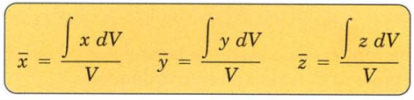
6.2.1 Centroids of Line, Areas and Volume
Centroid of Volume

Slide 12
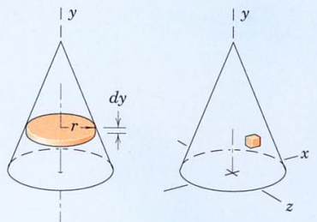
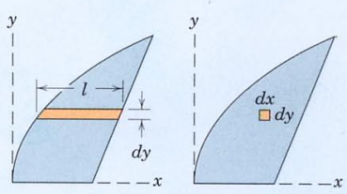
6.2.2 Choice of Element for Integration
Order of Element
Whenever possible, a first-order differential element should be selected in preference to a higher-order element so that only one integration will be required to cover the entire figure.

Slide 13
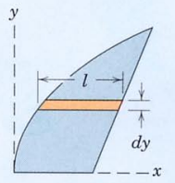
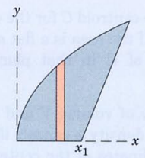
6.2.2 Choice of Element for Integration
2. Continuity
Whenever possible, we choose an element which can be integrated in one continuous operation to cover the figure.
X Correct

Slide 14
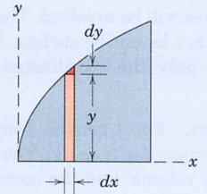

6.2.2 Choice of Element for Integration
3. Discarding Higher Order Term
Higher order term always be dropped compared with lower order terms.

Slide 15
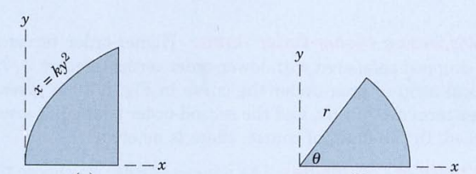
6.2.2 Choice of Element for Integration
4. Choice of Coordinates
Choose the coordinate system which best matches the boundaries of the figure.

Slide 16
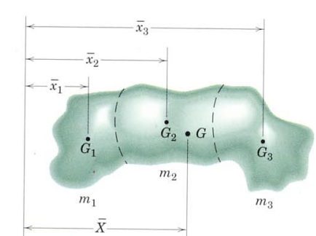


6.3 Composite Bodies and Figures, Approximation

Slide 17
THANK YOU!!!
QUESTION???????????????????????

